Slide 1
k Nearest Neighbor Classification

Slide 2
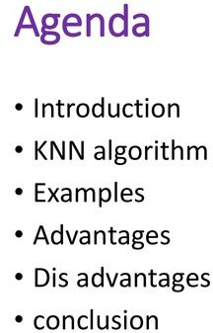

Slide 3
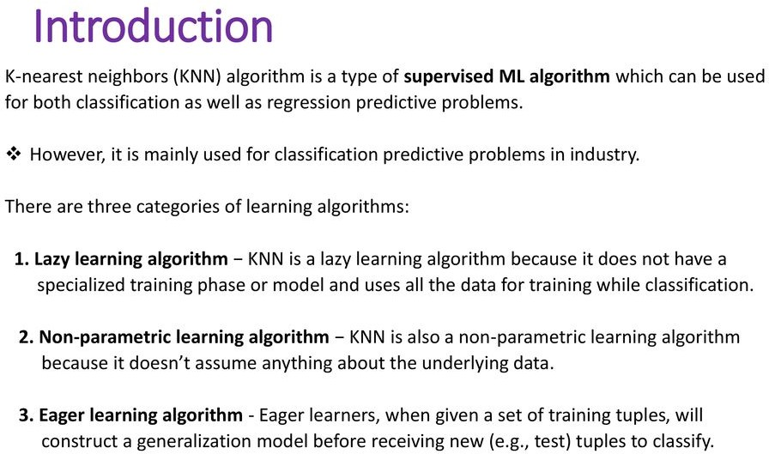

Slide 4
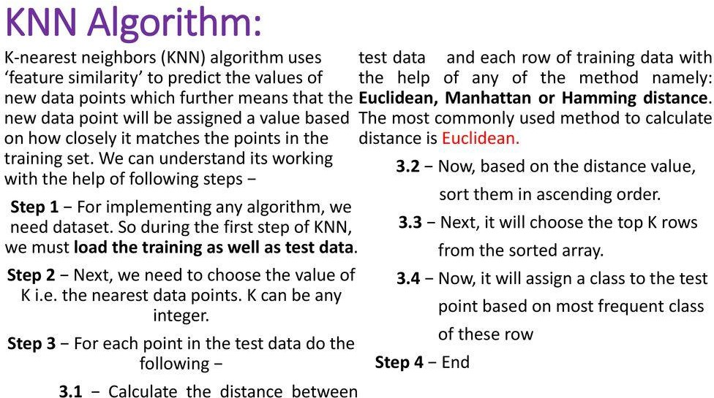

Slide 5
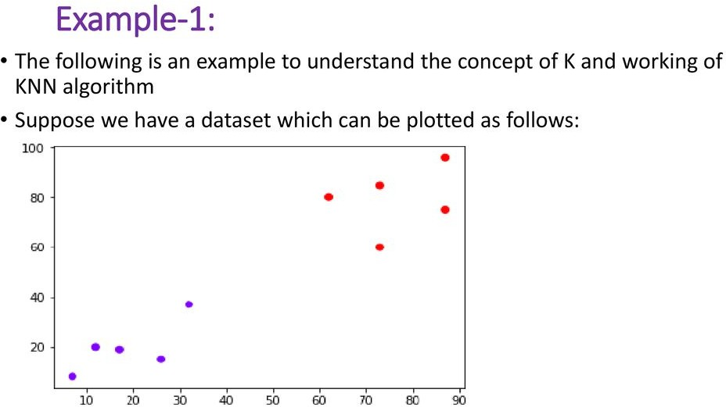

Slide 6
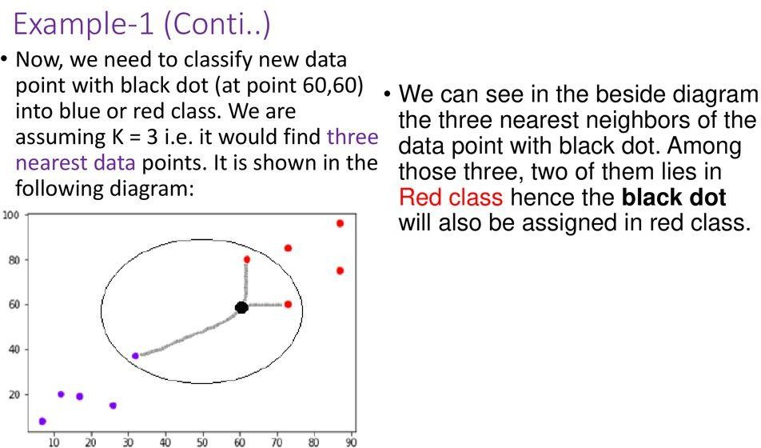

Slide 7
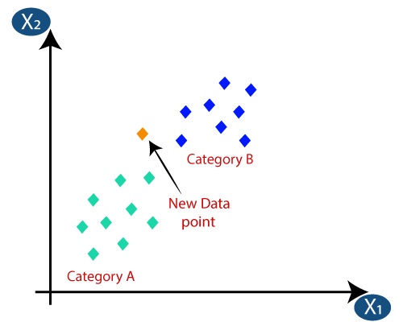
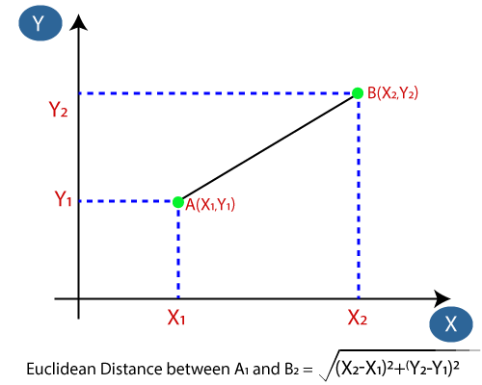

Slide 8
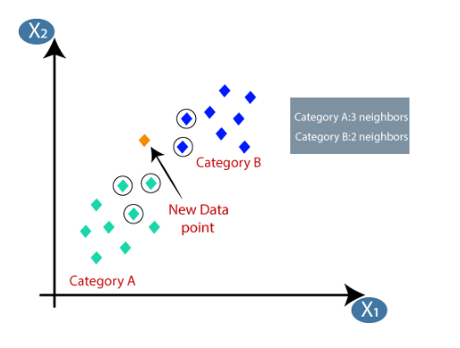
K=5
K=5

Slide 9
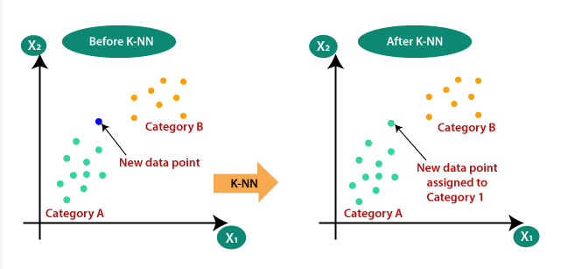

Slide 10
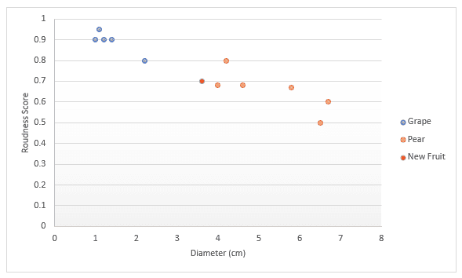

Slide 11
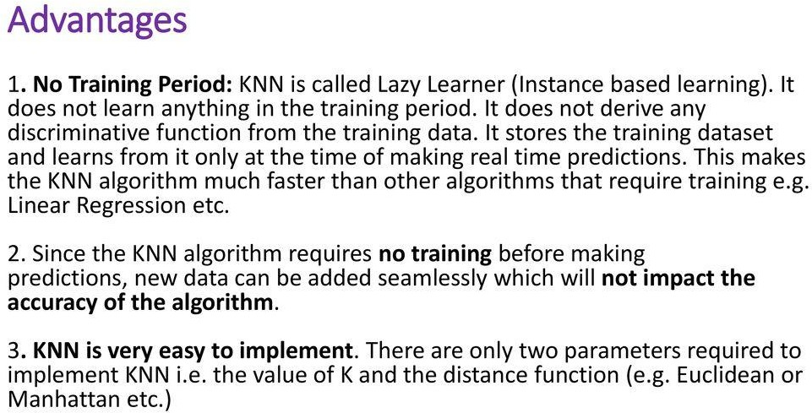

Slide 12
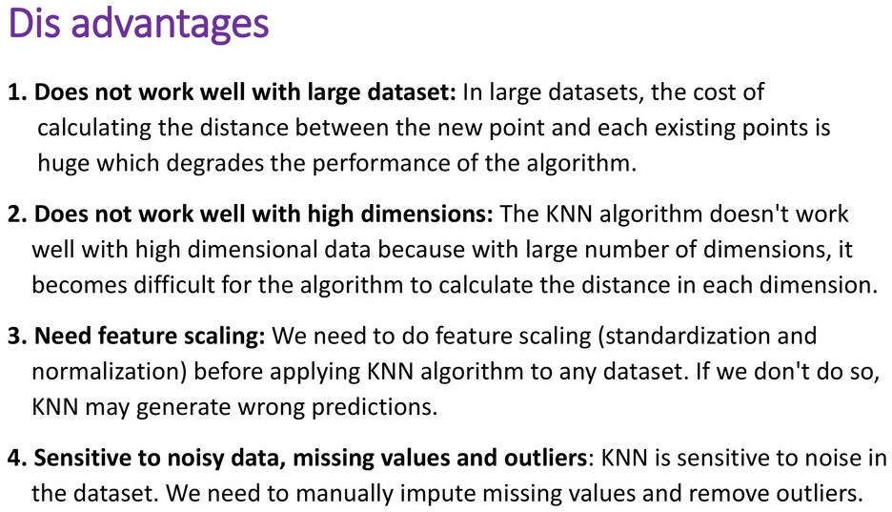

Slide 13
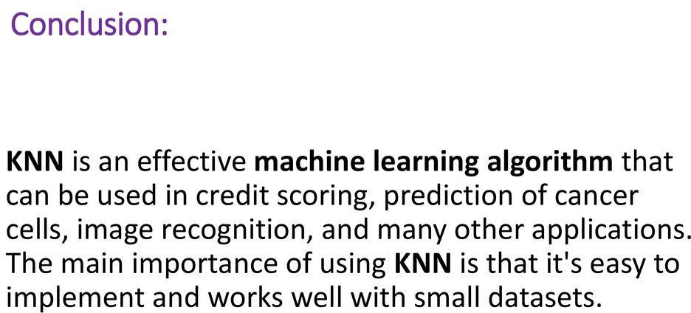

Slide 14
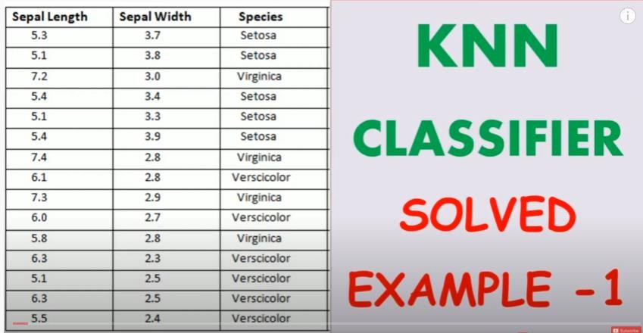

Slide 15
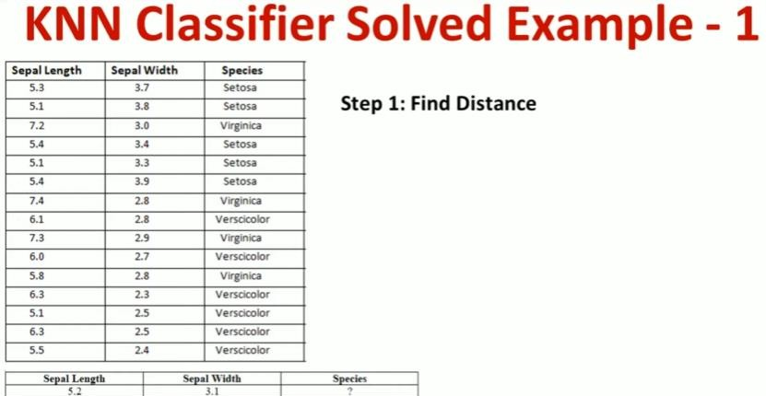

Slide 16
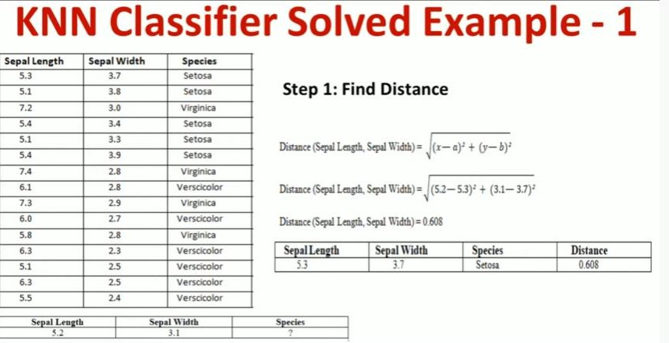

Slide 17
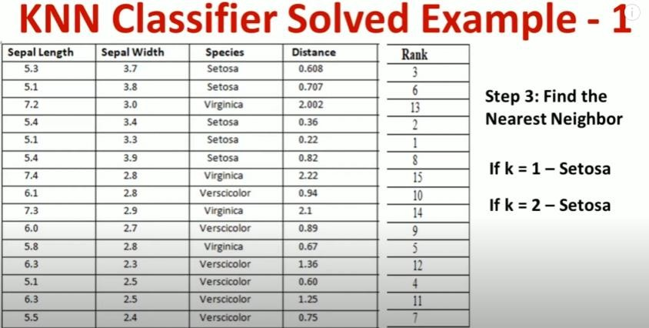

Slide 18
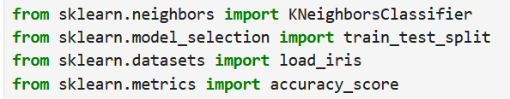
1. Import Required Libraries
sklearn.neighbors.KNeighborsClassifier: This imports the K-Nearest Neighbors (KNN) classifier, which is a machine learning algorithm used for classification.
sklearn.model_selection.train_test_split: This function is used to split the dataset into a training set and a testing set.
sklearn.datasets.load_iris: Loads the Iris dataset, which is a commonly used dataset in machine learning.
sklearn.metrics.accuracy_score: This function calculates the accuracy of the model by comparing predictions with actual values.

Slide 19

2. Load the dataset
load_iris(): Loads the Iris dataset, which contains flower measurements (sepal length, sepal width, petal length, and petal width) and their respective species labels (Setosa, Versicolor, or Virginica).
data.data: Contains the features (measurements of the flowers).
data.target: Contains the target labels (0 for Setosa, 1 for Versicolor, and 2 for Virginica).
X: Stores the features (sepal length, width, etc.).
y: Stores the target labels (species of the flower).

Slide 20
3. Split the dataset into training and testing sets
rain_test_split(X, y, test_size=0.2, random_state=42):
Splits the dataset into training and testing parts.
test_size=0.2: Uses 20% of the data for testing and 80% for training.
random_state=42: Ensures the split is reproducible (the same every time you run the code).
X_train: Training data (80% of X).
X_test: Testing data (20% of X).
y_train: Training labels (80% of y).
y_test: Testing labels (20% of y).

Slide 21

4. Create the KNN model
Creates an instance of the K-Nearest Neighbors (KNN) classifier.
n_neighbors=3: Uses 3 nearest neighbors to classify a data point
5. Train the model
fit(X_train, y_train): Trains the KNN model using the training data.
The model learns the relationship between features (X_train) and labels (y_train).

Slide 22

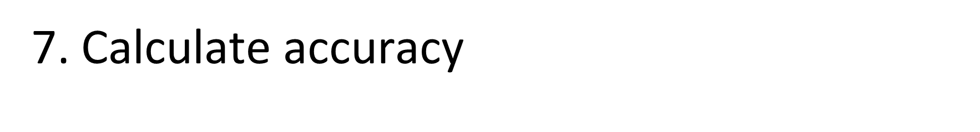
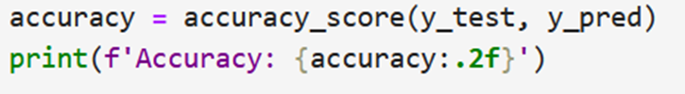
6. Make predictions
predict(X_test): Uses the trained model to predict the labels of the test dataset (X_test).
The model finds the 3 nearest neighbors of each test data point and assigns the most common label among them.
The predicted values are stored in y_pred.
accuracy_score(y_test, y_pred): Compares the predicted labels (y_pred) with the actual labels (y_test).
Accuracy is the percentage of correct predictions
f'Accuracy: {accuracy:.2f}': Prints the accuracy rounded to two decimal places.

Slide 23
Complete code
from sklearn.neighbors import KNeighborsClassifier
from sklearn.model_selection import train_test_split
from sklearn.datasets import load_iris
from sklearn.metrics import accuracy_score
# Load dataset
data = load_iris()
X, y = data.data, data.target
# Split into training and testing sets
X_train, X_test, y_train, y_test = train_test_split(X, y, test_size=0.2, random_state=42)
# Create KNN model
knn = KNeighborsClassifier(n_neighbors=3)
# Train model
knn.fit(X_train, y_train)
# Predict on test data
y_pred = knn.predict(X_test)
# Calculate accuracy
accuracy = accuracy_score(y_test, y_pred)
print(f'Accuracy: {accuracy:.2f}')

